Slide 1
DOELAP from 10,000 Feet
Musings of an Old Guy
Charles “Gus” Potter (Sandia National Labs) June 6, 2018

Slide 2
Assessor since 1997
22 assessments
18 different facilities
Charter member of oversight board
1997 until “relieved” in 2012 (15 years)
Administered Sandia’s first accreditation
Gus in 1997

Slide 3
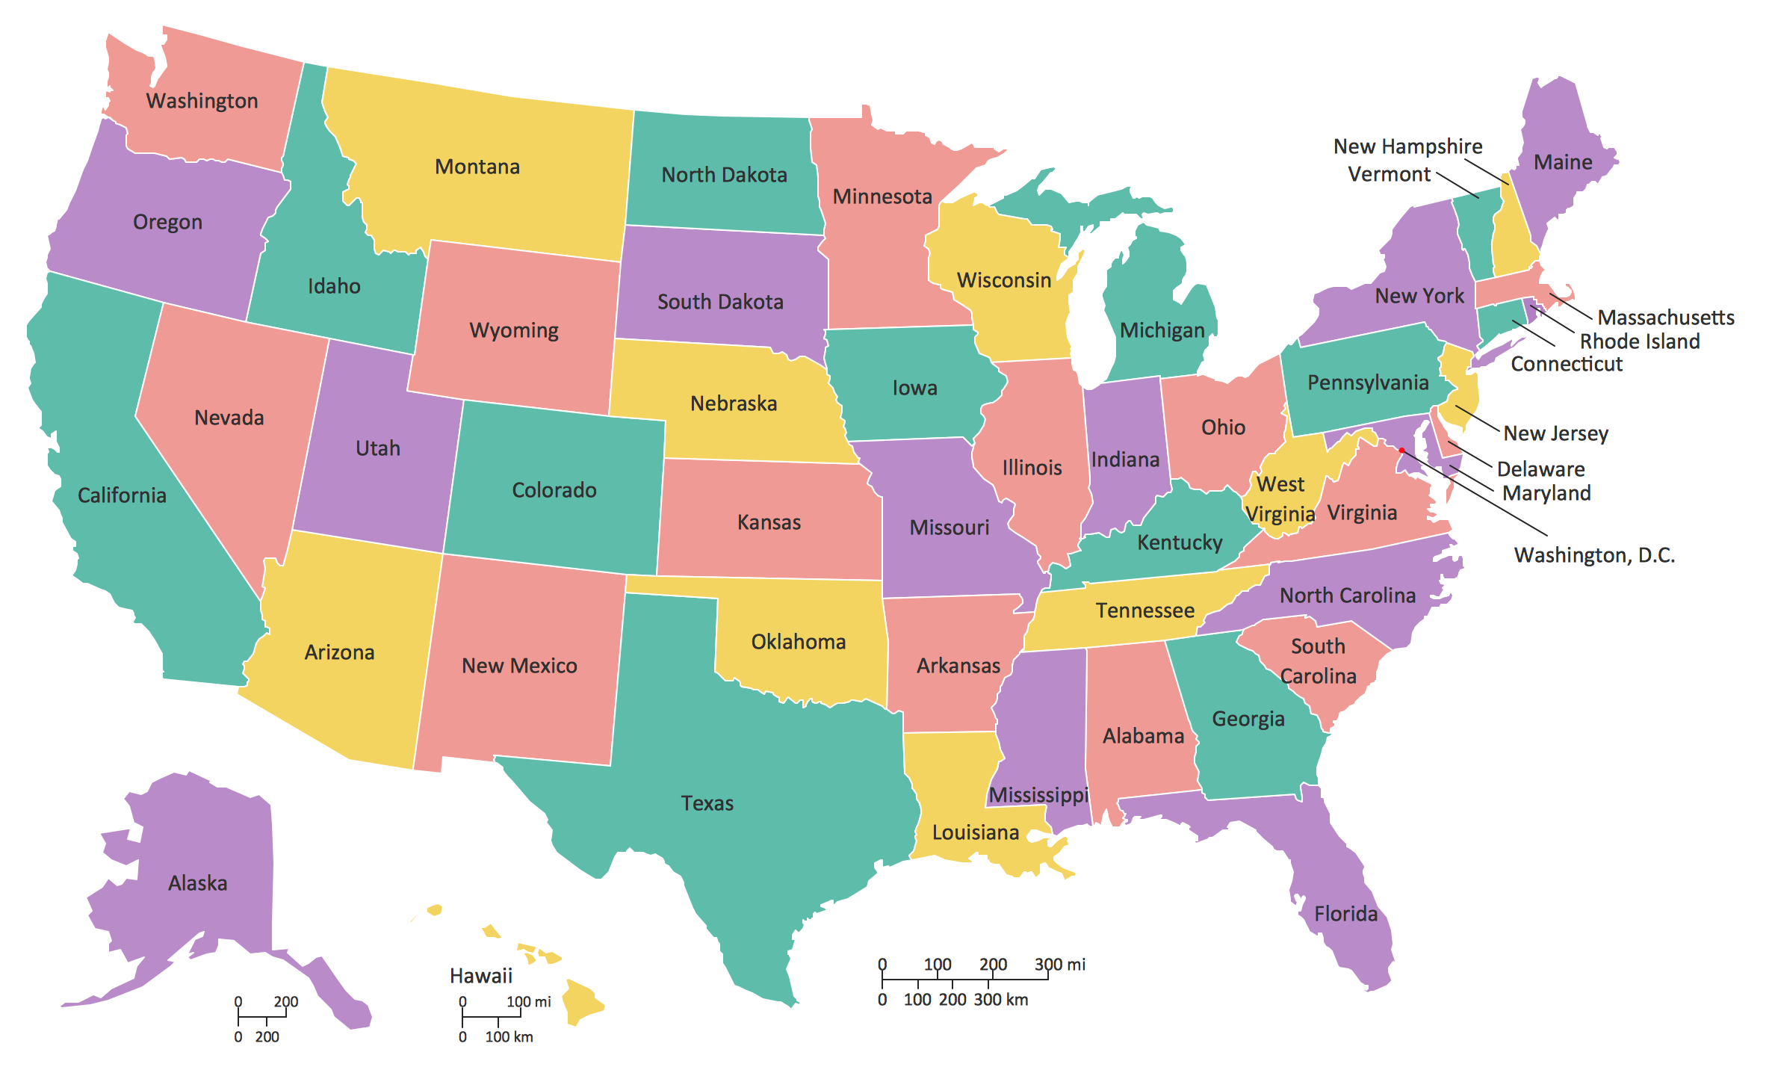

Slide 4
Each phase of the DOELAP process shows capability and competence.
Application
Performance testing
Assessment
Response to assessment
Recommendation of STM
Oversight board review
Award of certificate

Slide 5
The application shows the laboratory’s understanding of their own system.
What you can learn:
Additional facilities lab is providing services to
Onsite vs. offsite analytes
Questions are the same whether direct or indirect, but the importance of the answers may differ
System description: proportional counting (indirect), lung counting (direct) more likely to be home-grown systems
Data reduction: peak-search algorithm (gamma) vs. known analyte (alpha) vs. counting data (beta)
MDA: no requirements but indicative of competence

Slide 6
DOELAP is quality assurance, but quality control is vital to laboratory competence.
Quality Assurance
Quality Control
Stuff that makes you feel like you have a quality program
Quality manual
Performance testing
Assessments
Procedures
Intercomparisons
Stuff that makes you confident in the quality of each data package
Logs
Performance checks
Control samples
Standards
Data review
Notes:
Quality Assurance vs. Quality Control are like MDA vs. Lc

Slide 7
The performance test shows the lab’s capabilities under the best conditions.
The lab knows that this is a performance test!
It’s still OK if they mess it up, but they better have a full review with corrective actions explaining what the problem was.
May need an “extent of condition” review – was the problem pervasive?
Can they use their routine procedures?
DOELAP hasn’t always been able to tailor samples.
Pass is pass, fail is fail
It doesn’t hurt to try and track down why the lab was close to the edge.

Slide 8
Each assessment has its own flavor, but would you want that facility doing your work?
“I know in the first five minutes if the lab is competent.”
Can the staff effectively tell you what they are doing and why?
Are the facilities clean and well equipped?
How do they care for their samples (including maintaining identification)?
How do they ensure they perform every step of every procedure as and when required?
How to they handle anomalies?
How do they make sure that the data on the report is the same as the data that came out of each process?
Data collection (checklist) is required, but may not tell the whole story.
Find stuff to take home!

Slide 9
The implementation of the response to the previous assessment is a total judgement call.
Sometimes concerns are poorly written.
“In response to a concern from 2009, TestAmerica made a business decision that the 30-day frequency for alpha spectroscopy system source counts was adequate and their DOE clients agreed. However, TAR shall continue to evaluate the adequacy of the 30-day frequency and document the conclusions in a detailed report.” (QA 35, 37)
Sometimes the lab makes an effort at closing out the concern, but misses the mark.
Do you elevate to a deficiency?
Open a new concern?
How would you handle the one above if it wasn’t addressed?
Notes:
Note on checklist numbers
Concern C1 (originally Observation O-6)
The GEL SOW, RF)-1806 (January 2010), Section 4.1.2, requires random uncertainty, systematic uncertainty, and total propagated uncertainty (TPU) to be reported; however, only the TPU is found in the GEL data reports.
DOE-STD-1112-98 requires the Lc to be included in indirect radiobioassay reports and this requirement should be added to the statement of work. The tritium analysis procedure identification is not included on the Employee Tritium Radiobioassay Report prepared by Pantex Radiobioassay staff. DOELAP Checklist Item 2, bullets 3 and 4.

Slide 10
Poorly-written findings affect everyone!
The lab doesn’t know how to write a corrective action.
The STM doesn’t know what to expect in terms of a response, especially regarding the need for mid-cycle verification.
The OB doesn’t know whether the finding is classified properly and if the issue is detrimental to lab competency.
The next group of assessors doesn’t know how to evaluate completion of the corrective actions.

Slide 11
A finding should capture what you observe and why it matters.
What did you observe?
Why is it an issue?
What checklist item does it violate?
Does the situation indicate a current quality issue (deficiency) or the potential if the issue is not addressed (concern)?
Avoid words like “seems”, “appears”, etc. You either know it or you don’t. It’s unfair to give a finding when you’re not sure.
Think about how those reading the finding will interpret what it says.

Slide 12
The corrective action plan does not always address the issues.
How do I (or does the OB) know?
The concern must have been written properly.
The response should show an understanding and a desire to actually fix it.
The response should be verifiable and able to be completed within cycle.
No matter how bad the situation seems, the lab has the full cycle to complete the corrective actions (for a concern).
Even if the corrective action – as written – won’t do the job, the concern is closed if it’s been completed.

Slide 13
The STM has the unenviable job of putting it all together with a recommendation.
The STM provides a cover letter with a yes/no recommendation and any additional information that needs addressing. The full package includes
Cover letter
Application
Performance testing results
Assessment Report
Response to assessment
Any other documentation deemed necessary

Slide 14
The Oversight Board does the best job it can from a distance.
The OB’s job is to recommend accreditation to the DA – nothing more (for accreditations, anyway).
The OB only has what you have – application, performance test results, assessment report – plus the intended corrective actions.
The best thing you can do to help the OB is to write the assessment report the best you can – be clear, descriptive, etc.

Slide 15
We are all here to make the DA look good.
We can’t do anything about regulatory/enforcement aspects.
We can provide a high-quality assurance/accreditation program for which the ability to obtain a certificate has true meaning.
When we are doing DOELAP work, we represent DOELAP, not our home laboratories (think emergency response).

