Slide 1
DOELAP Webinar for Federal Oversight Personnel
November 13, 2024
Teams

Slide 2
DOE Laboratory Accreditation Program For Radiobioassay and Personnel Dosimetry
Required by 10 CFR 835.402, Occupational Radiation Protection
(c-1) Radiological workers who, under typical conditions, are likely to receive a committed effective dose of 0.1 rem (0.001 Sv) or more from all occupational radionuclide intakes in a year;
(d) Internal dose monitoring programs implemented to demonstrate compliance with § 835.402(c) shall be adequate to demonstrate compliance with the dose limits established in subpart C of this part and shall be:
(1) Accredited, or excepted from accreditation, in accordance with the DOE Laboratory Accreditation Program for Radiobioassay; or,
(2) Determined by the Secretarial Officer responsible for environment, safety and health matters to have performance substantially equivalent to that of programs accredited under the DOE Laboratory Accreditation Program for Radiobioassay
DOE Federal and Contractor Workforce – 132,392*
Number of Individuals Monitored – 72,830 (55%)*
Number with Measurable Dose - 14,912 (20% of monitored)*
Average measurable dose ~50 mrem
*CY2017-2021 Average. DOE Occupational Radiation Exposure Report for CY 2021

Slide 3
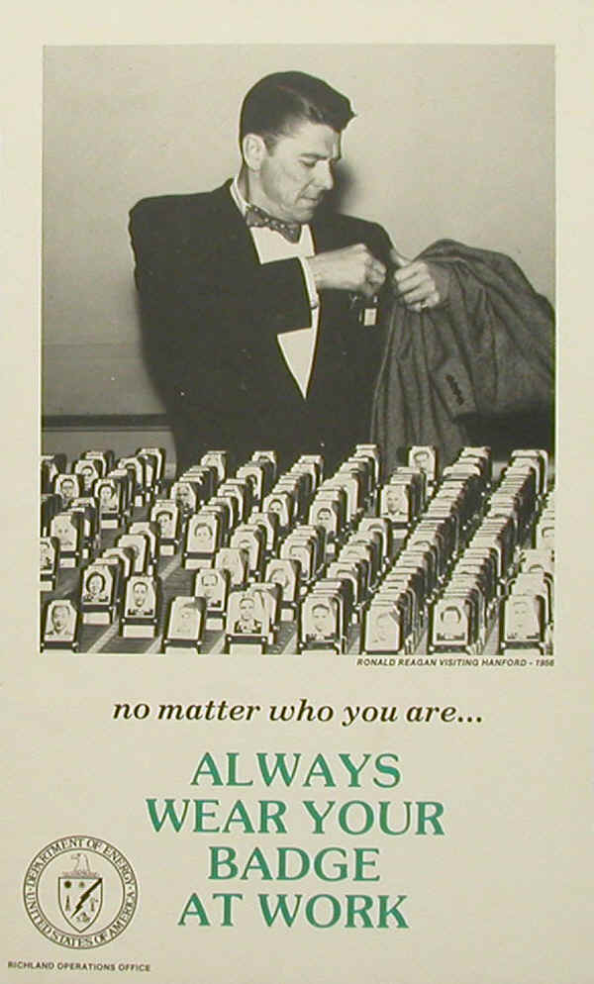
Personnel Dosimetry
Assessment of exposure to radiation outside the body.
Accomplished by wearing a dosimeter for radiological work
Whole body
Extremity
Currently 24 DOELAP accredited programs
Supported by 35 volunteer assessors

Slide 4
Radiobioassay
Assessment of dose from radionuclides incorporated inside the body.
Indirect radiobioassay (in vitro)
Estimate of radioactive material in excreta or in other biological material removed from the body.
Direct radiobioassay (in vivo)
Measurement of radioactive material in the body utilizing instrumentation that detects radiation emitted
Currently 18 DOELAP accredited programs
Supported by 36 volunteer assessors
DOELAP covers the measurement process. Use of those measurements and biokinetic models to determine and assign dose (internal dosimetry) is not part of DOELAP (DOE-STD-1121)

Slide 5



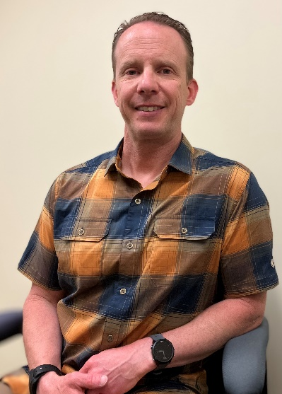
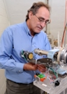
DOELAP Team
David Pugh, DOELAP Administrator
Office of Worker Safety and Health Policy
Guy Backstrom, Director
DOE Radiological and Environmental Sciences Laboratory
George Chiu, Health Physicist
Office of Worker Safety and Health Policy
Steve Bohrer, Senior Technical Manager
DOE Radiological and Environmental Sciences Laboratory
Laird Bean, Assessment Coordinator
DOE Radiological and Environmental Sciences Laboratory

Slide 6
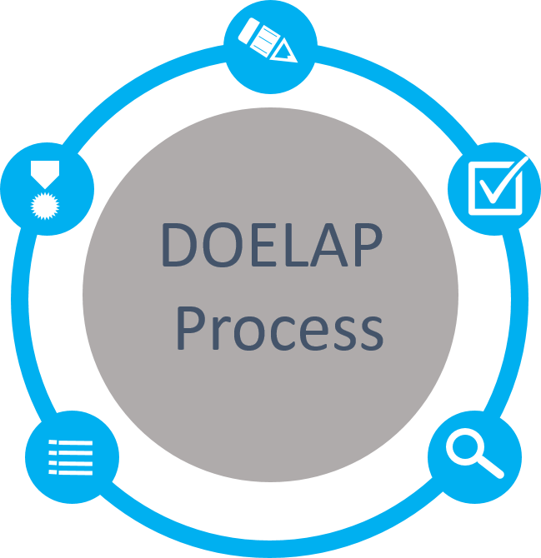
DOELAP Process
Application
Categories based on site requirements
Quality Assurance Program
Field Office Review
Performance Testing
ANSI N13.11, Personnel Dosimetry Performance Criteria and Testing
ANSI N13.32, Performance Testing for Extremity Dosimeters
ANSI N13.30, Performance Criteria for Radiobioassay
Accreditation
Period of 3 years
Notify DOELAP of changes
Memo goes to Field Office
Oversight Board Review
Complete Package
Recommendations to Administrator
On-Site Assessment
Direct observation and evaluation
Conducted by technical experts

Slide 7
Application
Correct contact info
Categories meet site requirements
Information is complete
Vendors/service providers
Vendors apply separately for themselves
Sites include vendor information
11/18 radiobioassay programs use General Engineering Laboratories (GEL)
13/24 personnel dosimetry programs use Landauer
Sites must show ability to understand how vendors are performing work, receive and interpret data, test vendor performance, etc.

Slide 8
Performance Testing
Results are reported/evaluated for all required categories
When failures occur, an acceptable CA is developed and followed through
Retesting
personnel dosimetry automatically enrolls the program in the next test cycle (6-month cycle)
Radiobioassay provides retesting samples out of the normal schedule (12-month cycle)
DOE-STD-1111-20XX allows for max of two retests
Sites should be tracking vendor failures
Sites are tested every 3 years. Current vendors tested yearly

Slide 9
On-site Assessment
Conducted by DOELAP-trained assessors
Generally 2-3 assessors over 2-3 days
DOE Field Office is notified and should attend opening and closing meetings
Assessors use DOELAP-created checklist based on relevant DOE standards
Checklists are available at https://resl.id.energy.gov/doelap/doelap.html
Follow up on previous corrective actions

Slide 10
Findings (DOE-STD-1111-20XX)
Observation – suggested improvement or noteworthy practice, no response required
Concern – marginal compliance, but doesn’t have “significant, immediate, and continuing adverse impact” on quality
Develop and submit CAP to STM through Field Office within 45 days
Complete CAP within one year
Evaluate effectiveness
Deficiency – “significant, immediate, and continuing adverse impact” on quality. Results in suspension of application
Develop and submit CAP to STM through Field Office within 45 days
Complete CAs within 60 days of assessment close-out and submit evidence to STM (through Field Office)
Evaluate effectiveness
Removed requirement for automatic elevation of repeated concern

Slide 11
Radiobioassay Findings Distribution

Slide 12
Personnel Dosimetry Findings

Slide 13
Corrective Action Plans
Submitted by site to STM (through Field Office)
Short turn around, adequate root cause analysis?
STM reviews, sends to assessors for review
STM sends comments (if any) to site for CA revision
Final CAP sent to STM with FO approval
Must include estimated completion dates. Standard allows up to 1 year for completion. Should be realistic and risk-and evidence-based. Sites generally don’t need to take the full year.
OSB review may recommend accreditation with contingencies on CAP completion

Slide 14
Oversight Board Review
OSB made up of technical experts from various DOE sites
Role is to review recommendations made by the STM and advise the DOELAP Administrator regarding approval or denial of accreditation
Generally meets once per year
Review accreditation packets
Make recommendations
Not binding

Slide 15
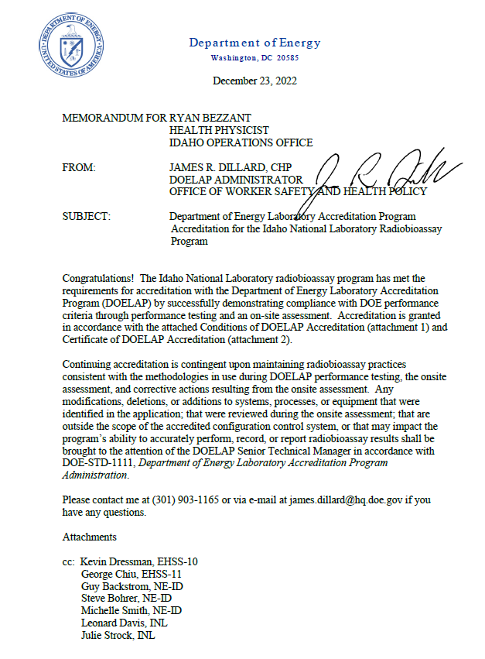
Accreditation
Memo from DOELAP Administrator to Field Office
DOE site holds the accreditation
Vendors are not DOELAP accredited or certified
Accreditation period is 3 years
Mid-cycle monitoring visits are possible

Slide 16
Modifications to Accredited Program
Technical Equivalency
Substantive changes to elements of accredited program
Not like-for-like replacement
TE request generally done by site in consultation with STM
Formal TE request comes through Field Office, and memo granting TE goes to Field Office
Amendment
A change to the scope of an accredited program shall be authorized by an amendment to the Conditions of Accreditation
Formal amendment request comes through Field Office, and memo with updated Conditions of Accreditation goes to Field Office

Slide 17
Oversight Opportunities
Management assessments
Blind audit program
Mid-cycle internal self-assessment to DOELAP checklist
Continuity of accreditation
Please notify us if you leave a position as Field Office POC

Slide 18
Assessor Opportunity
Assessor: individual recognized by DOELAP as a technical expert who has been trained and qualified to perform assessments in support of DOELAP accreditation process.
Send recommendation along with resume to Steve Bohrer, bohrerse@id.doe.gov.
Planned personnel Dosimetry Assessor Training at INL in September 2026

Slide 19

Contacts
powered
https://resl.id.energy.gov/doelap/doelap.html
One-stop-shop for DOE Standards, assessment checklists, webinar presentations, etc.
Steve Bohrer, STM-DOELAP
bohrerse@id.doe.gov
Shane Steidley, STM-Chemistry
steidlsd@id.doe.gov
Guy Backstrom, RESL Director
backstlg@id.doe.gov
Questions?

