Slide 1
Radiological and Environmental Sciences Laboratory
FY2019 MAPEP WEBINAR
July 30, 2019

Slide 2
MAPEP – Analytical Performance
Performance Based Testing Program – Not Method Based
Analytical methods are not prescribed by MAPEP
Analytical Methods used Must generate acceptable results in three areas – Accuracy, Detection Limit, Statistically Zero
Analytical procedures are tested on real world sample matrices; not easily soluble matrices that have nothing to do with real samples.
Stated Detection Limits are evaluated through Sensitivity Tests.
Ability to report Statistically Zero results when activity is not present.
Onsite assessments are usually not needed and are of little value once Analytical Performance is established.

Slide 3
MAPEP – PT Samples
PT Samples contain chemical and radiochemical interferences that test analytical issues routinely encountered on real samples that will affect the accuracy of the results.
MAPEP was specifically designed for this over 25 years ago.
Laboratory Control Samples in a simple matrix should never be used to validate the performance and accuracy of an analytical procedure – No real world problems.
Experimental Results are compared directly to the NIST traceable reference values… RESL is NIST’s reference laboratory.

Slide 4
MAPEP – Performance Based
MAPEP is Not Method Based – It is Performance Based
There is a belief, that if you follow a procedure, the results obtained are adequate and acceptable whether or not they are accurate and convey what is actually present in the sample.
Example: Leaching procedures will leave unknown and undetected activities of Pu, Am, U, Tc and other radionuclides in the sample and the environment.
This thought process makes inaccurate results acceptable simply because an inadequate procedure was followed and documented.

Slide 5
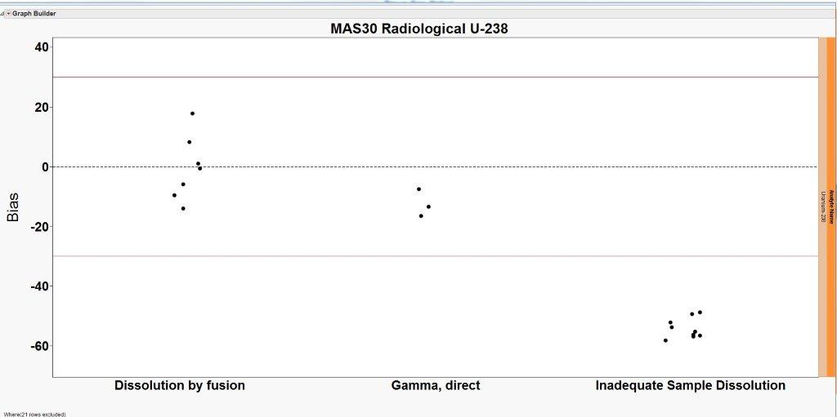
U-238 in soil
Shown are 18 Lab data out of 45 reported. Only 10 passed. 27 Labs reported zero….
Adequate Analytical Method Inadequate Method

Slide 6
Non-MAPEP – Method Based Analysis
https://www.hanford.gov/files.cfm/HASQARD_Focus_Group_Minutes_-_2019-02-26_(APPROVED).pdf
“The MAPEP samples are performance-based PT samples…”
“... stated that elimination of MAPEP as a requirement is beneficial for her laboratory…”
“The 222S laboratory has to modify their procedures from the way they typically handle Hanford samples.”
“For example, to prepare MAPEP samples in a manner that provides an acceptable result for the MAPEP requires sample preparation using hydrofluoric acid. That reagent is not used with Hanford samples.”
“The MAPEP knows what the total concentration of an analyte is in the matrix provided and expects that result regardless of method used.”
“Therefore, MAPEP is not an appropriate program for determining adequate PT results…”
This type of unscientific thinking makes inaccurate results acceptable by a few, simply because an inadequate procedure was followed and documented.

Slide 7
MAPEP Program Status
Test Sessions 39 and 40 were completed in FY2019
Performance Testing of International Labs Reinstated
Technical Areas of Interest
Certificates of Accreditation

Slide 8
MAPEP Program Status
Test Session 41 is scheduled to ship in early September
Five different matrices
Soil, Water, Vegetation, Air Filter and Special Matrix
19 radionuclides 20 inorganic analytes
Ten different studies
MaS, MaW, RdF, RdV, GrW, GrF, XaW, XrM
UaW, PuW(w/Np-237)

Slide 9
MAPEP Program Status
International Participation
Test Session 36 stopped
Test Session 39 reinstated
Automated International MAPEP Application

Slide 10
Technical Highlights of MAPEP Series 39 and 40
Specific Areas of Interest
Gross Alpha/Beta (GrW and GrF)
Screening Alpha/Beta/Gamma Water
U-235/238 Mass Spectrometry (UaW)
Pu-239/240 Mass Spectrometry (PuW)
Np-237(In Series 41)?
Ra-226 Water
Tc-99 Soil
Special Radiological Matrix

Slide 11
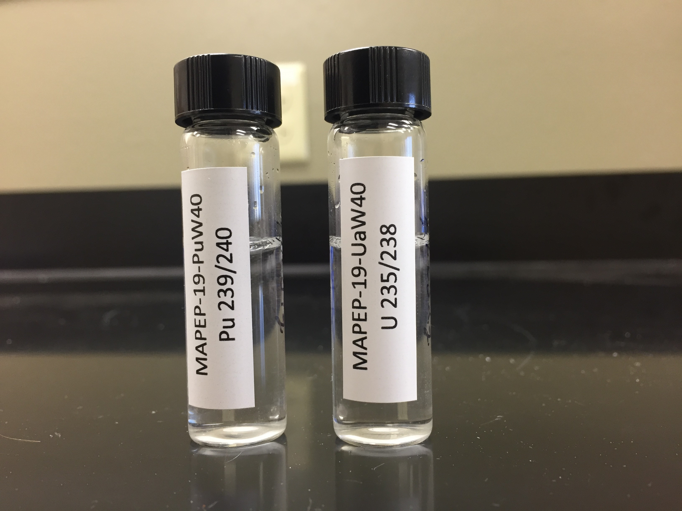
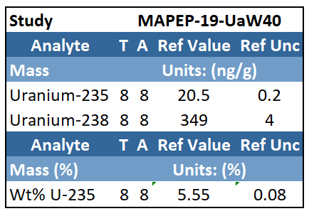
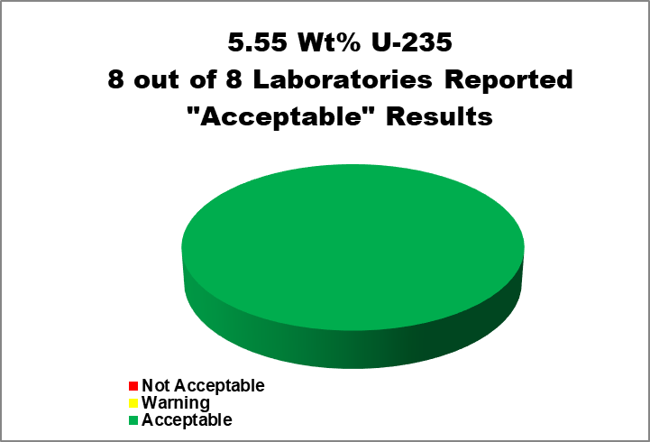
Uranium Mass Spectrometry

Slide 12
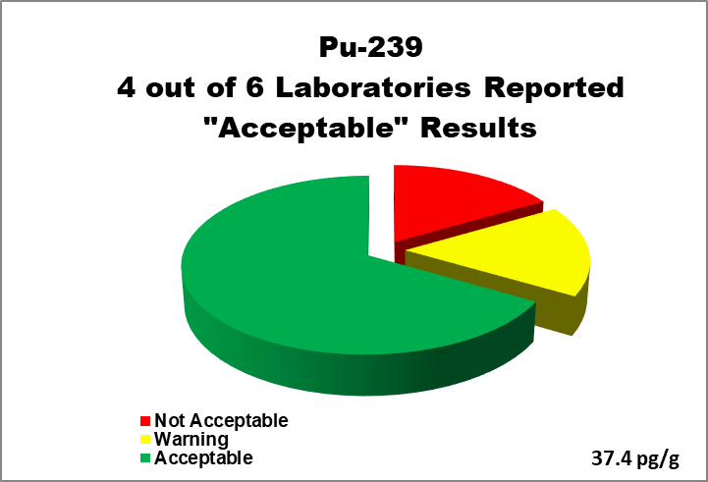
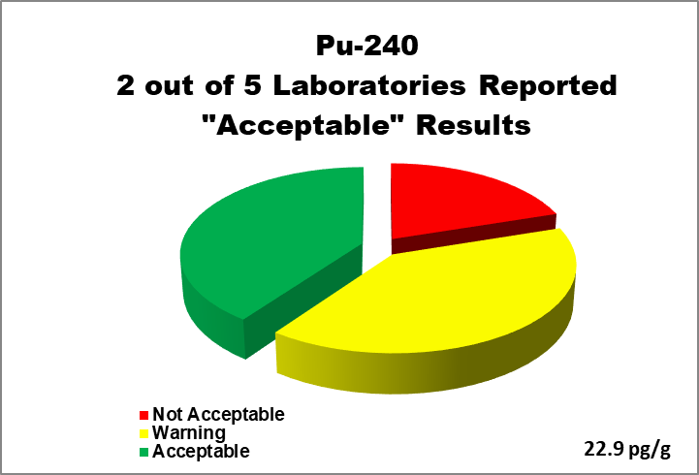
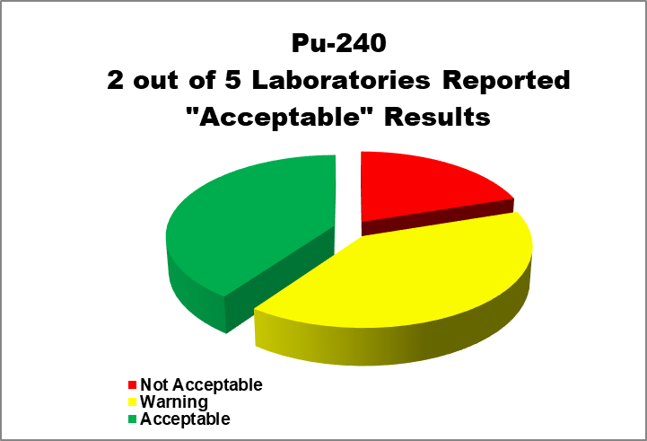
Plutonium Mass Spectrometry

Slide 13
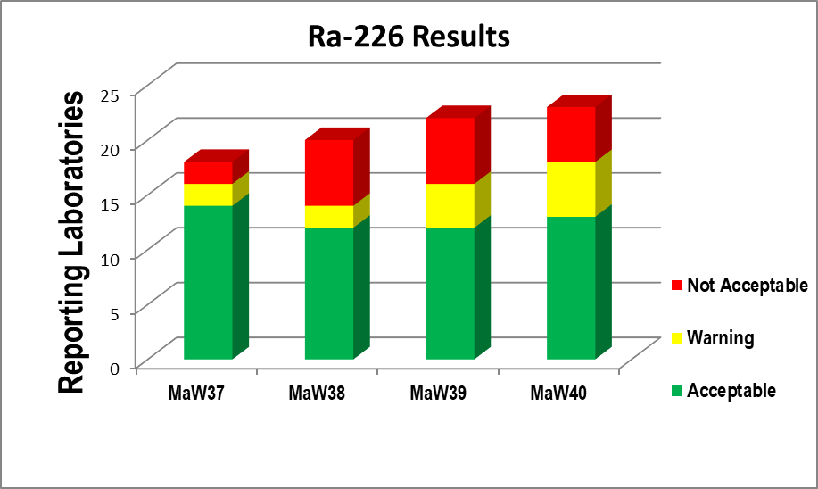
MAPEP Water
0.858 Bq/L
0.257 Bq/L
0.442 Bq/L
0.672 Bq/L

Slide 14
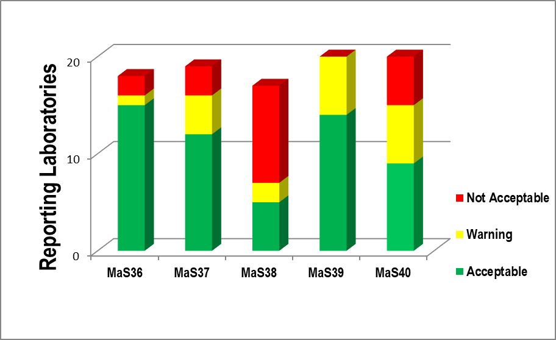
Technetium-99

Slide 15
Performance Evaluation of Tc-99 in Soil
TcO₄⁻ anion should be a completely water soluble species.
However…
It has been found that TcO₄⁻ is highly insoluble in soils containing “high” levels of silica and complex silicates.
Treatment of these soils with HF was necessary to obtain accurate results for Tc.

Slide 16
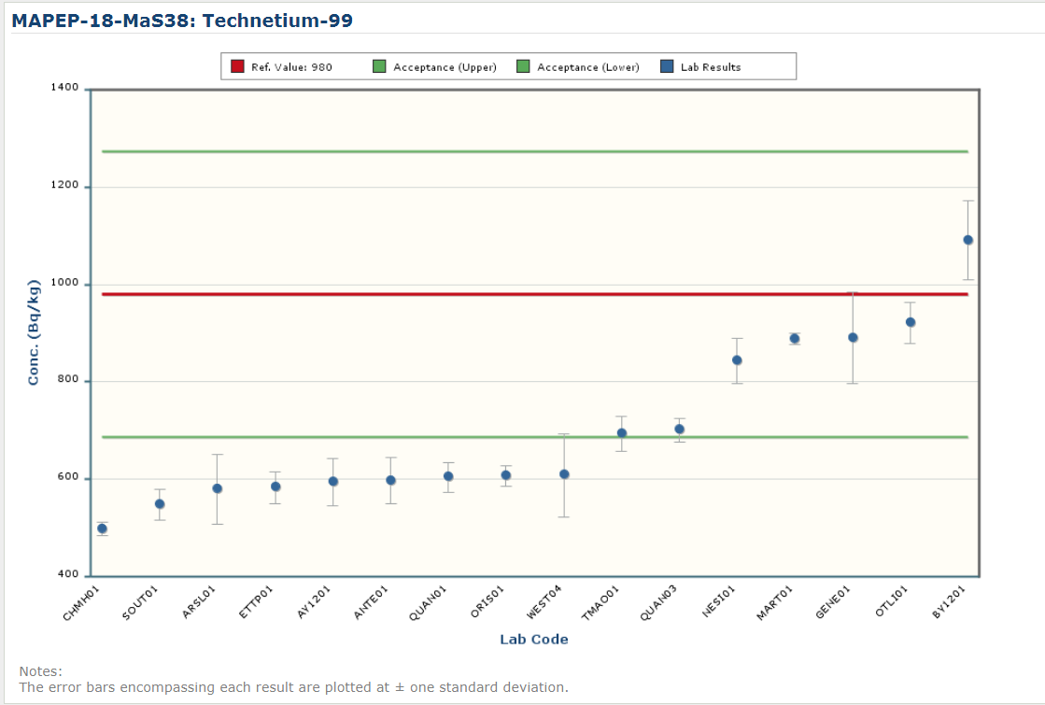
MaS38 – Technetium-99

Slide 17
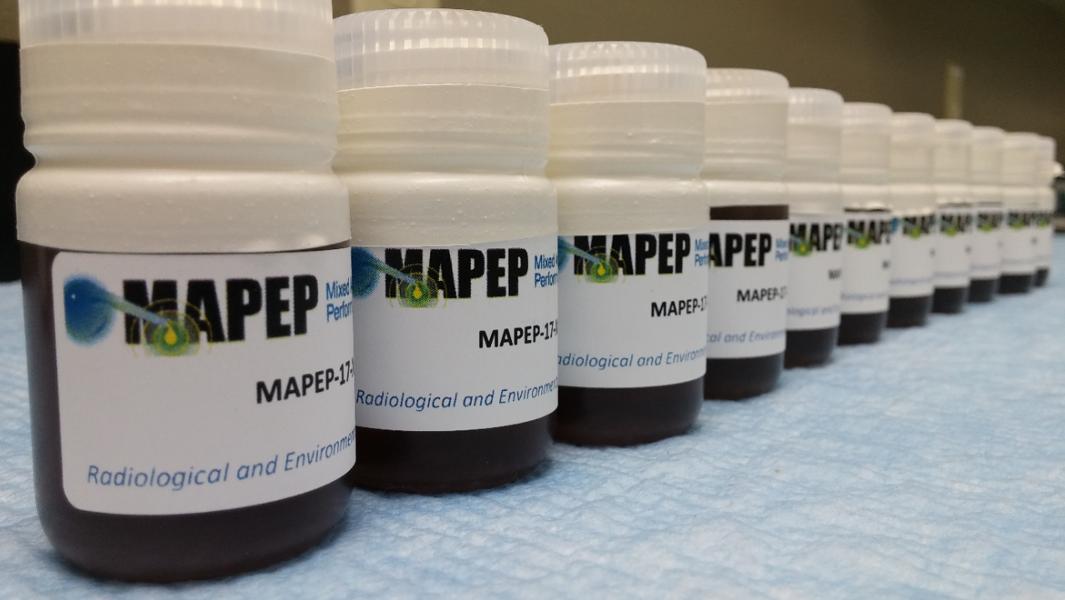
MAPEP Special Radiological Matrix (XrM)
Real World Matrices
Concrete
Asphalt
Soil containing aged mixed fission products
Organic matrix – water soluble
Eggs
Milk
Vienna Sausage
Nasal Swab

Slide 18
Special Radiological Matrix XrM
Special Radiological Matrix (XrM) – Real Matrix / Unknown Analytes…
Non punitive, promotes increased scientific capability and credibility …
Undisclosed sample matrix and radionuclides.
Results are only evaluated based on bias from the known.
Acceptance flags are not assigned to results.
Designed to encourage participants to test full analytical capabilities.
Tell your QA people to chill…. This is about Science

Slide 19
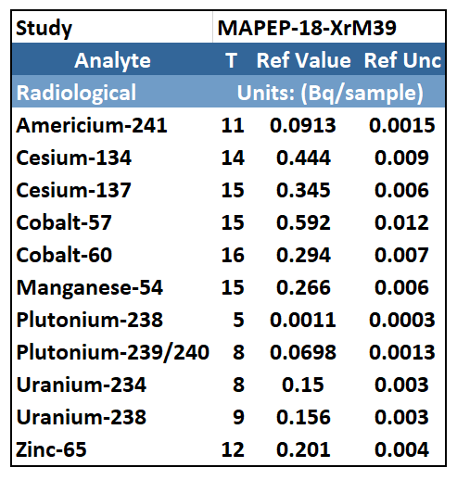
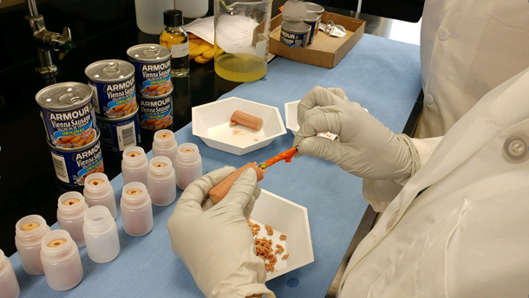
XrM39 Vienna Sausage

Slide 20
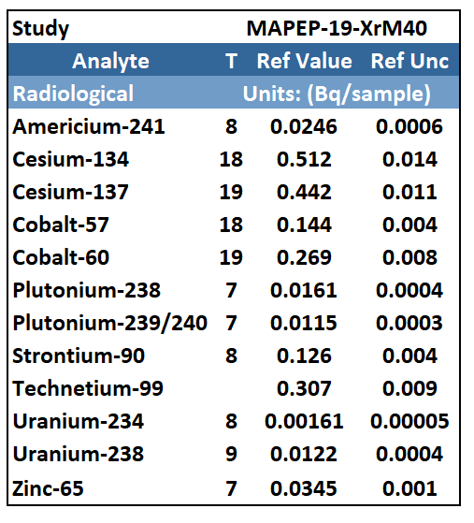
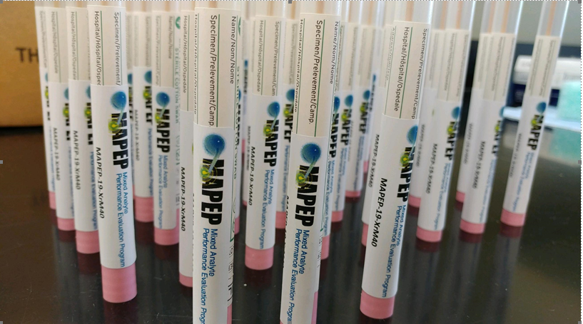
XrM40 Nasal Swab

Slide 21
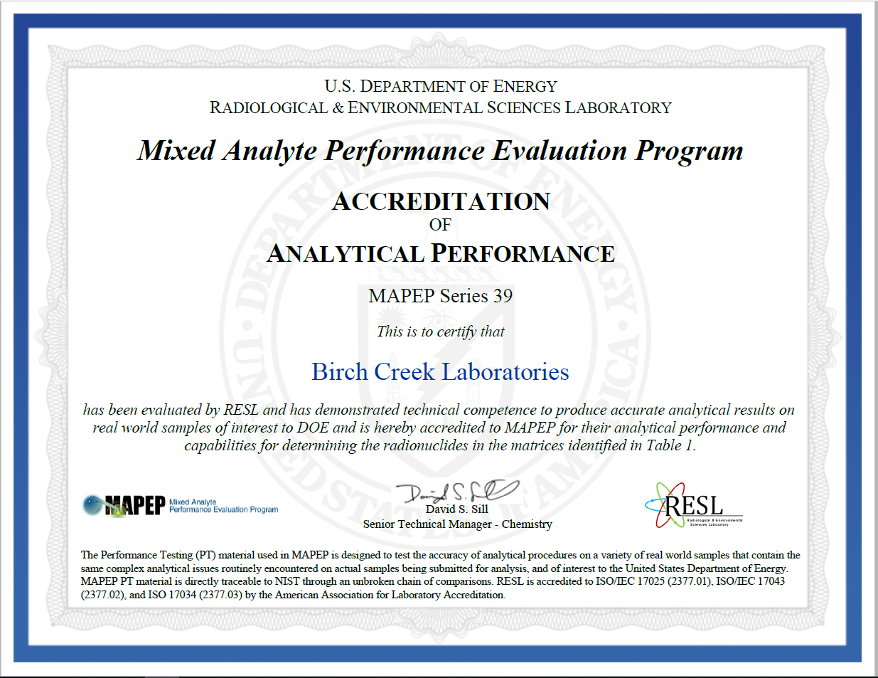
Accreditation of Analytical Performance

Slide 22
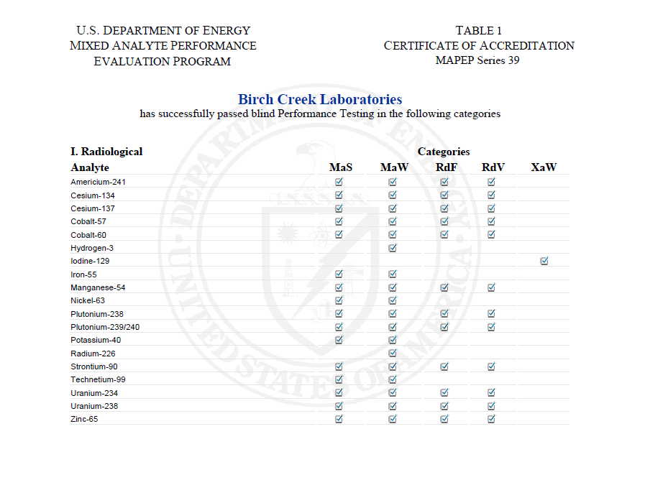
Accreditation of Analytical Performance

Slide 23
Accreditation of Analytical Performance

Slide 24
Discussion
Questions/Future Performance Testing Sample Needs/Interest?

Slide 25
Websites and Contact Information
RESL: http://www.id.energy.gov/resl/
MAPEP: http://www/id.energy.gov/resl/mapep
Anita R. Bhatt, RESL Director: 208-526-1273 bhattar@id.doe.gov
David Sill, Sr. Technical Manager Chemistry: 208-526-8031 sillds@id.doe.gov
Shane Steidley, Radiochemist: 208-526-8249 steidlsd@id.doe.gov

